Slide 1
Challenge
To create new digital services and business opportunities made possible by LuxTurrim5G and μMEC, for a real smart city.
Team: HAAM

Slide 2
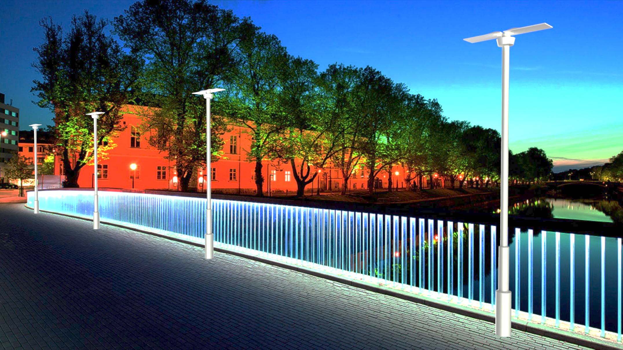
5G IoT light poles for Smart City
μMEC is a HW/SW platform to connect sensors, screens and other services to 5G network, for real time data.

Slide 3



Smart City Challenges
Congestion and transportation issues
Air & water quality,
Energy efficiency and mobility.

Slide 4
Real world example
KANSAS CITY : “The Strategy: Make the urban core a more ‘Quantified Community,’ by collecting and analyzing data on:
Travel flows
Traffic crashes
Energy usage
Air pollution
Residents’ health and physical activity”
US Govt. Smart City challenge - https://www.transportation.gov/smartcity

Slide 5
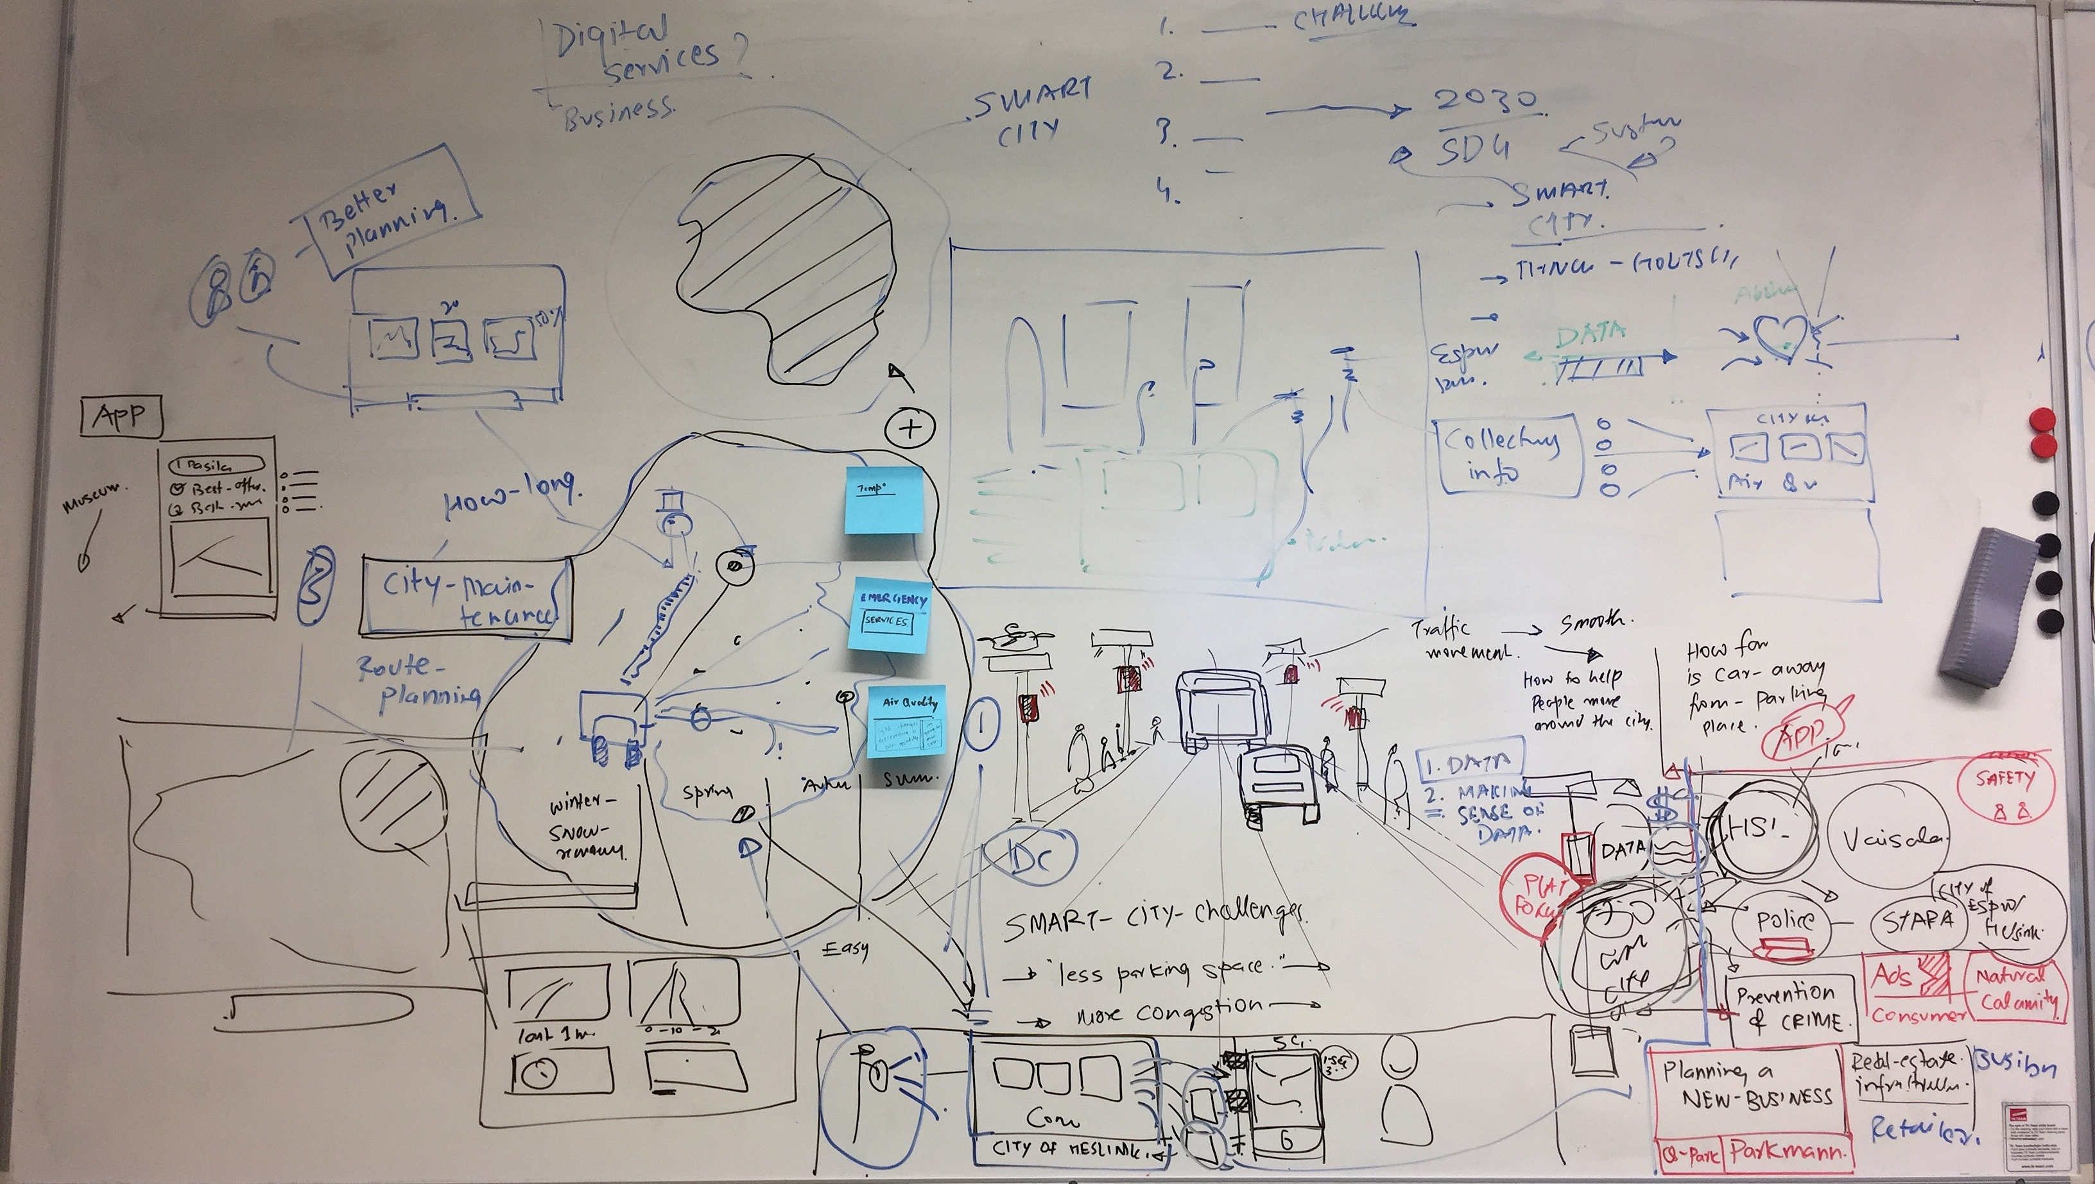

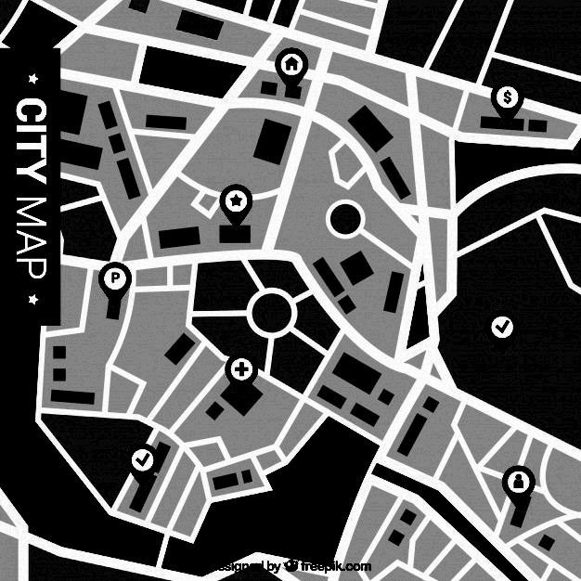



5G light pole mesh
?

Slide 6
Our Approach
detect movement & number of people and vehicles
Analysis of data into meaningful interpretations
Improving quality of life by providing meaningful data decisions for citizens, public officials and businesses.
.
+

Slide 8
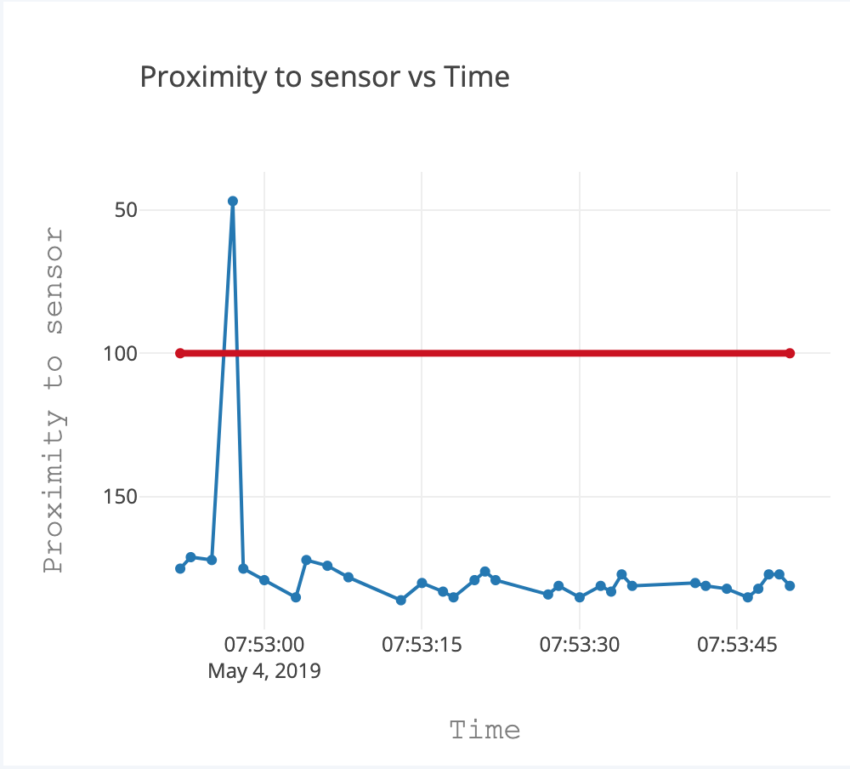
Proximity sensor as an example
Demo done using motion/proximity sensor with 25 cm range.
Display variation in distance of object from sensor with time.
The horizontal line has no meaning in the context of the demo itself, but can be used as an indicator (‘threshold’) in real-life.

Slide 9
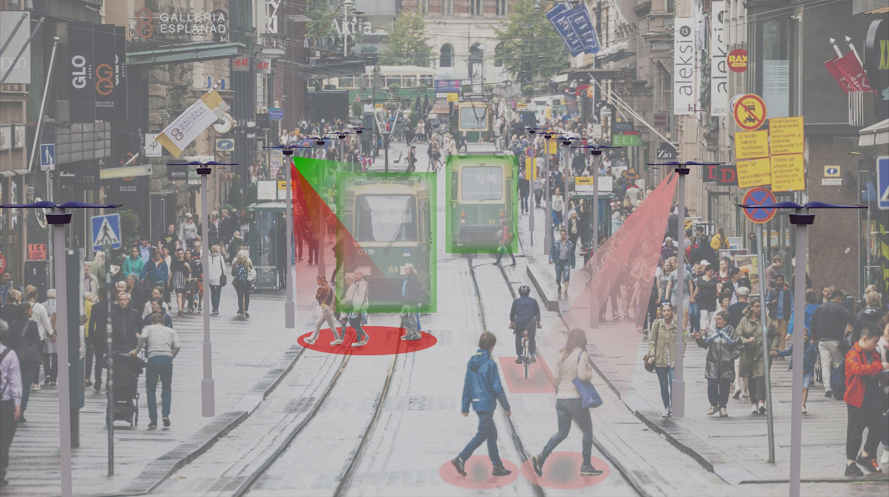

Slide 10
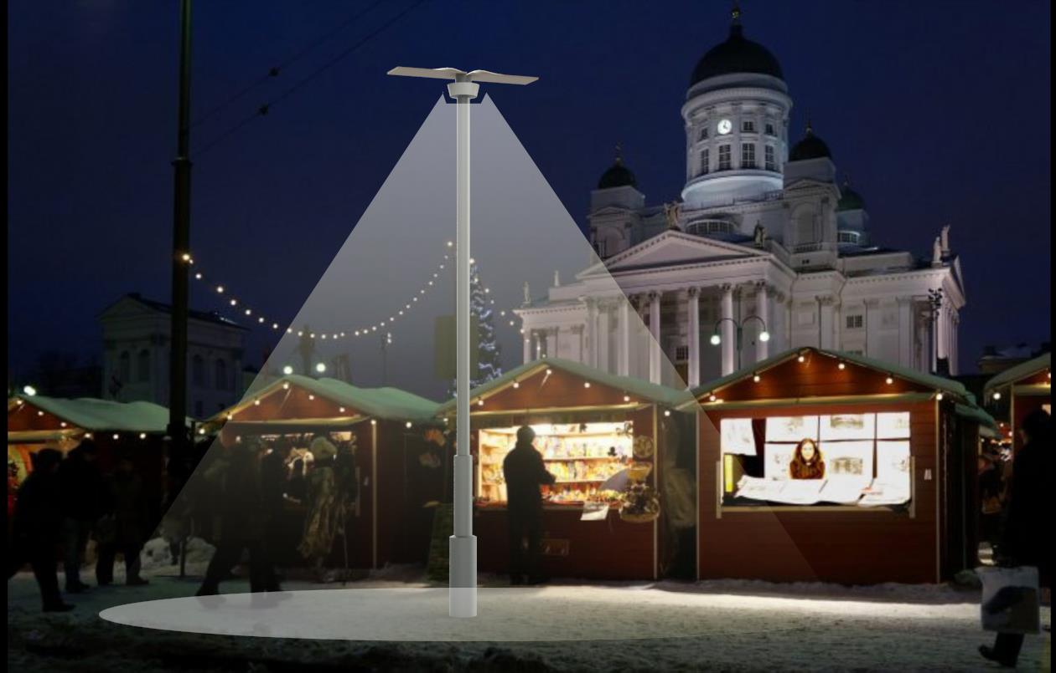
Data can be either accessed in real time, or stored & analyzed into meaningful statistics

Slide 11




Our Concept :*City Integrated Data Center
Platform

Slide 12
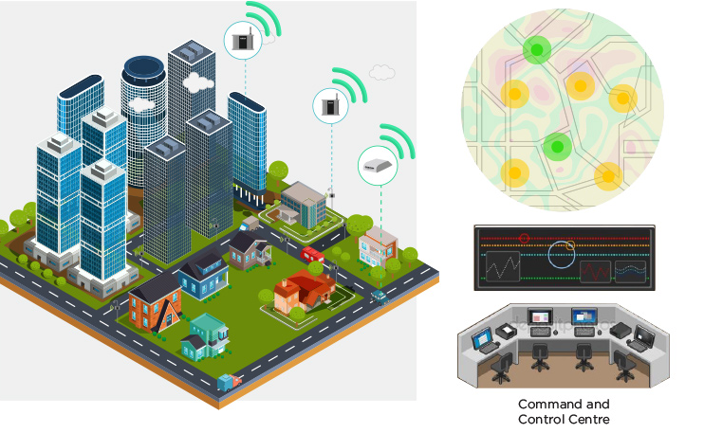


City Integrated Data Center
INTERNAL SAVINGS : SAFETY, CITY MAINTENANCE OPTIMIZATION
NEW BUSINESS OPPORTUNITIES: DATA SERVICES TO 3RD PARTIES
DATA COLLECTION
DATA ANALYSIS

Slide 13



INTERNAL SAVINGS : SAFETY, CITY MAINTENANCE OPTIMIZATION
City reacting dynamically to people movement
People safety, Crime prevention
Street maintenance optimization
Traffic guidance optimization to prevent traffic jams

Slide 14




NEW BUSINESS OPPORTUNITIES: DATA SERVICES TO 3RD PARTIES
INTERNAL SAVINGS : SAFETY, CITY MAINTENANCE OPTIMIZATION
Large retail chains -
Big data of consumer movement
Customer approximations of nearby competitors
Risk management for new retail store locations
Business HUB & Educational center

Slide 15
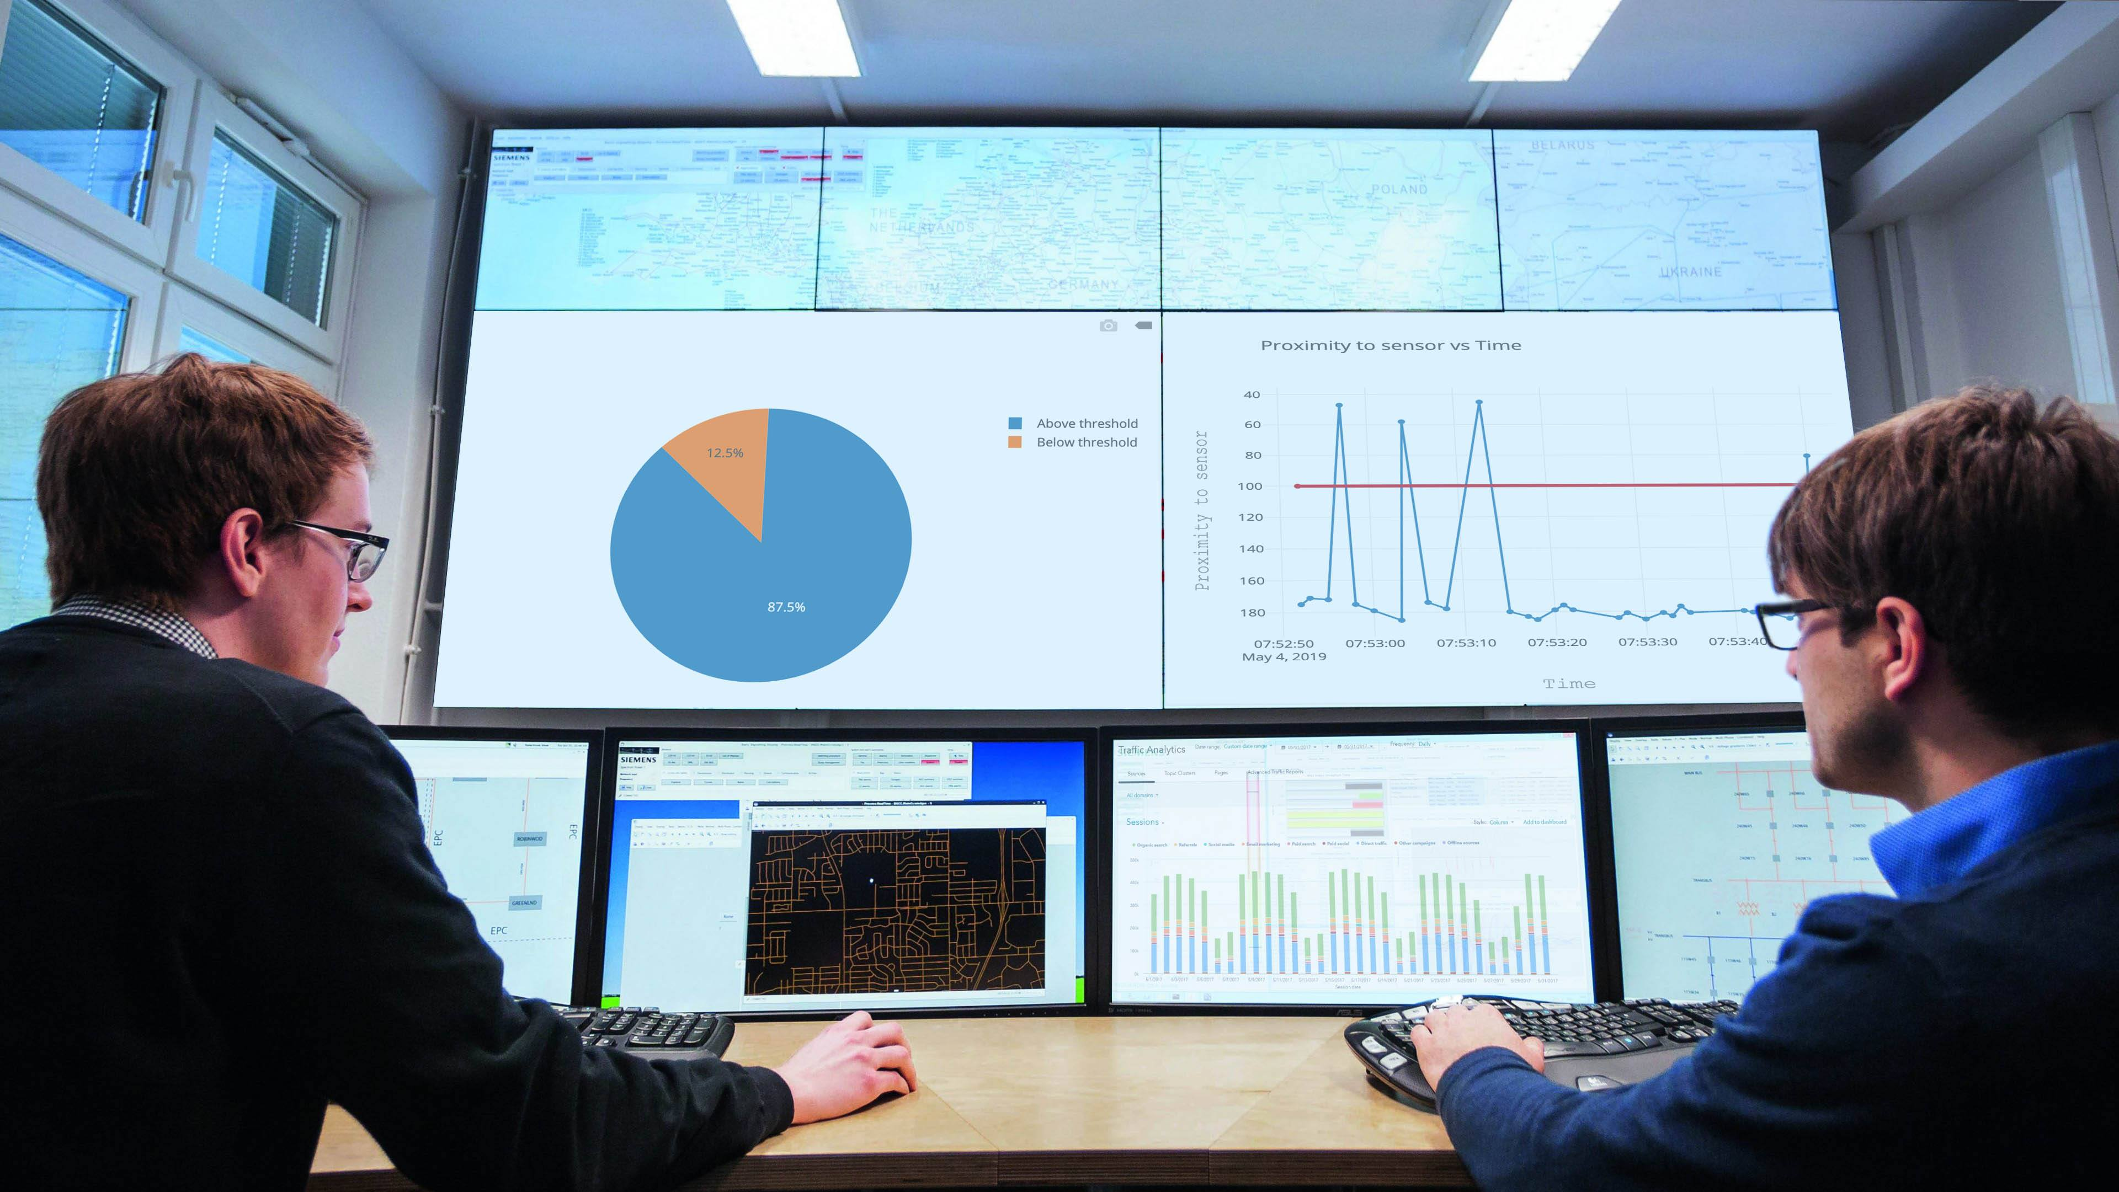
How does it make money ($)?
+
=

Slide 16
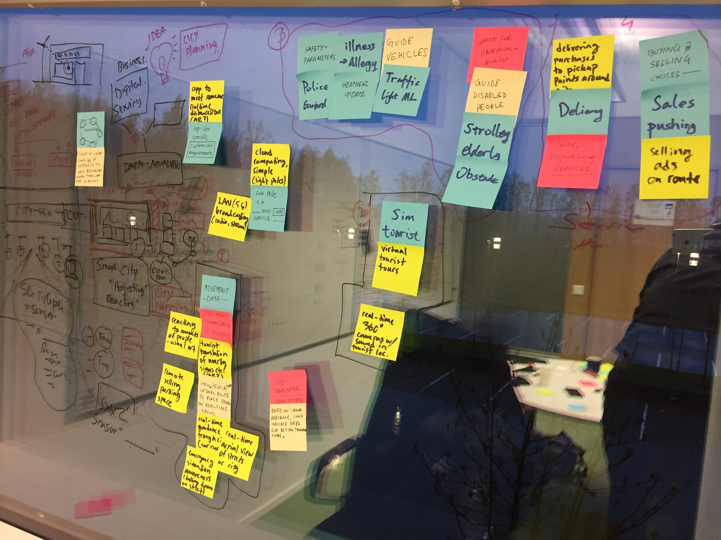
Collection of random ideas
Real time weather, pollen and dust updates
Safety / Public warnings
AI traffic lights
Disaster monitoring
Crime prevention
Guiding disabled people
City space reacting to movement of people (visual arts)
Translation of city signs for toursist (AR)
Directing transportation to crowded areas
Each light pole is a mini service point.
Optimizing routes through the city for the people
Virtual Tourist tour (cam on location)
Real time 360 degree webcams with sound
Pushing targetted sales campagins or ads to pedesterians
Drone dispatching services
Purchase delivery to pickup points around the city
Real Estate estimation from sensor data
Remote selling parking space
App to find someone in real-time location (AR)
Selling sensor data for APP makers
LAN broadcasting on 5G
Simple Cloud computing on light pole network
Automated detection of medical emergency

Slide 17
THANK YOU! ☺

